Slide 1
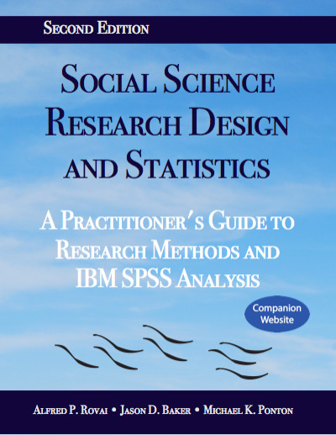
Social Science Research Design and Statistics, 2/e
Alfred P. Rovai, Jason D. Baker, and Michael K. Ponton
McNemar Test
PowerPoint Prepared by
Alfred P. Rovai
IBM® SPSS® Screen Prints Courtesy of International Business Machines Corporation,
© International Business Machines Corporation.

Slide 2
Uses of the McNemar Test
The McNemar test is a nonparametric chi-square procedure that compares proportions obtained from a 2 x 2 contingency table where the row variable (A) is the DV and the column variable (B) is the IV.
The test is used to determine if there is a statistically significant difference between the probability of a (0,1) pair and the probability of a (1,0) pair.
Dichotomous variables are employed where data are coded as "1" for those participants that display the property defined by the variable in question and "0" for those who do not display that property. The test addresses two possible outcomes (presence/absence of a characteristic) on each measurement.

Slide 3
Uses of the McNemar Test
The test is often used for the situation where one tests for the presence (1) or absence (0) of something and variable A is the state at the first observation (i.e., pretest) and variable B is the state at the second observation (i.e., posttest).
Below is a diagram of the data structure:
 |  | B |  | Totals
 |  | 0 | 1
A | 0 | d | c | c + d
 | 1 | b | a | a + b
Totals |  | b + d | a + c | N

Slide 4
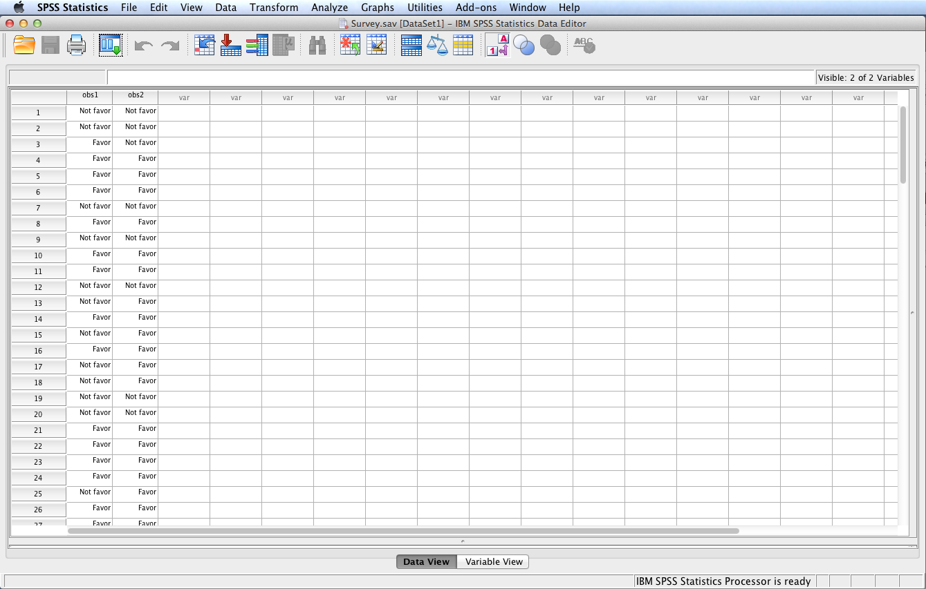
Open the dataset Survey.sav.
File available at http://www.watertreepress.com/stats

Slide 5
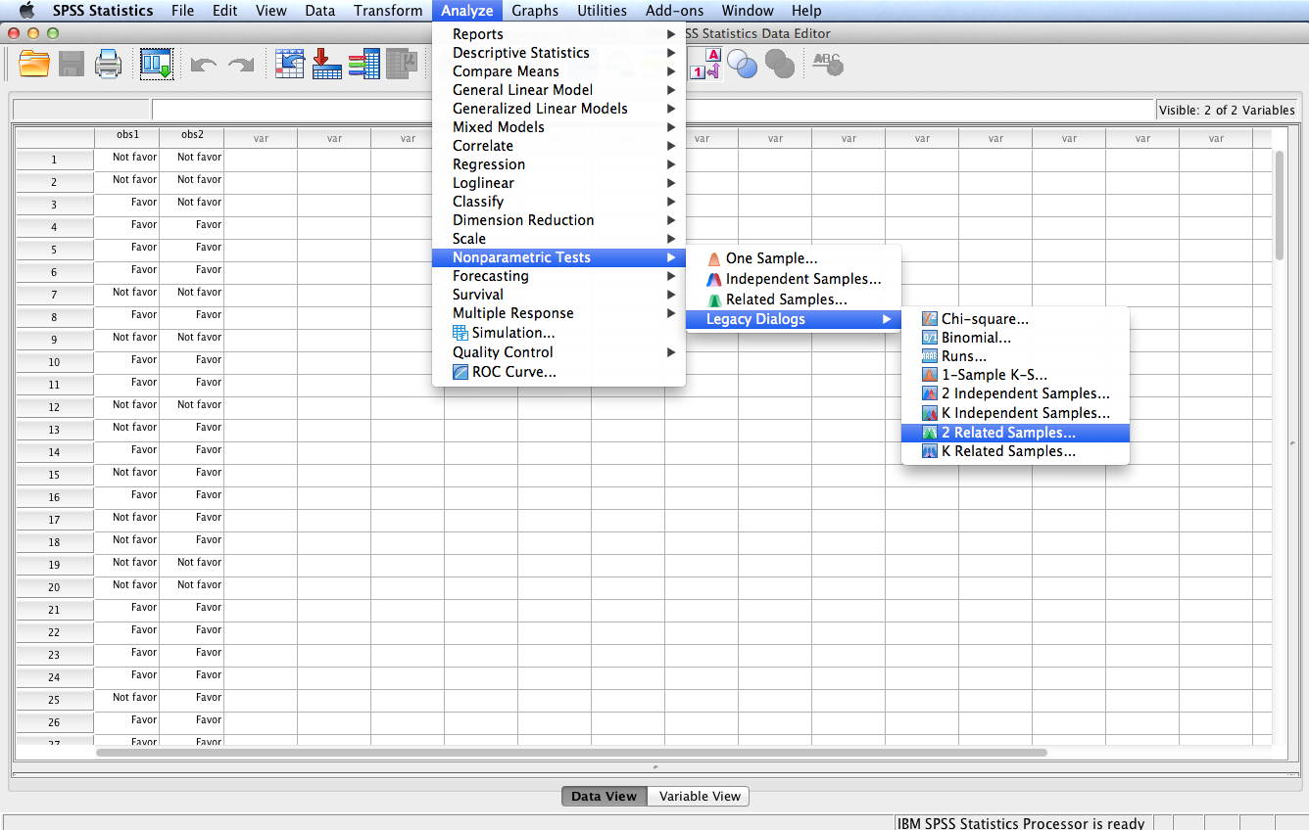
Follow the menu as indicated to conduct the McNemar test using Legacy Dialogs. Alternatively, one can run the test using the Related Samples option under the Nonparametric Tests menu.

Slide 6
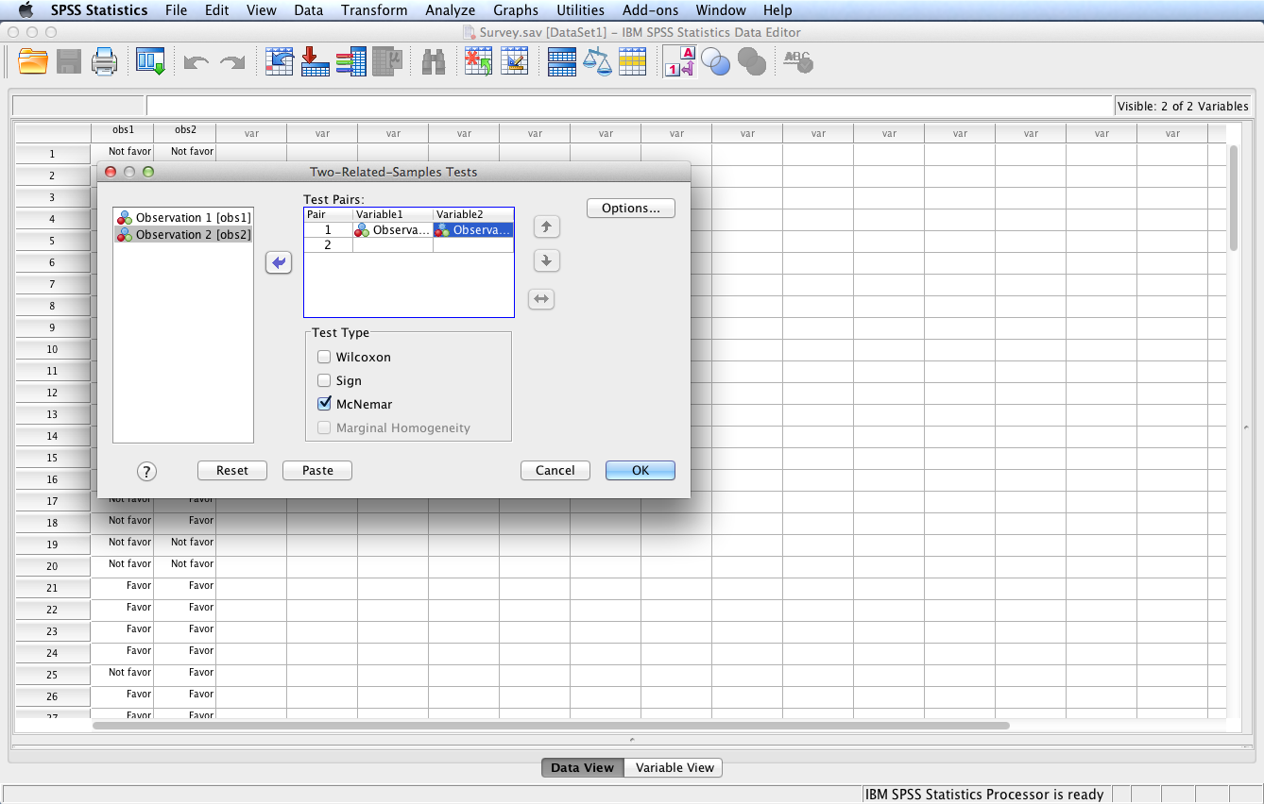
In this example, we will test the following null hypothesis:
H_{o}: There is no change in student favorability toward longer summer residencies between observation 1 and observation 2.
Select and move observation 1 and observation 2 to the Test Pairs: box. Check McNemar as the Test Type. Click Options...

Slide 7
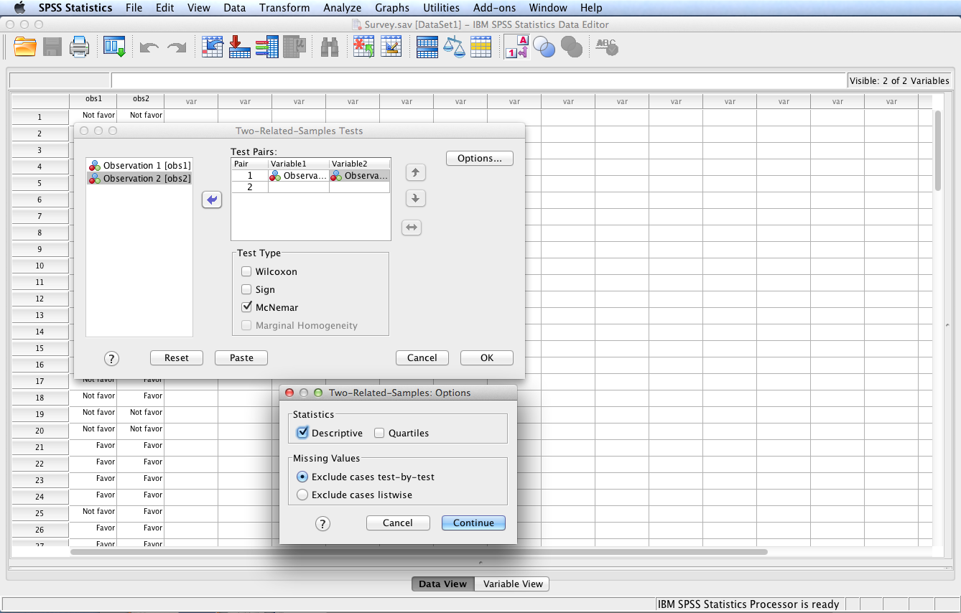
Check Descriptive to generate descriptive statistics; click Continue then OK.

Slide 8
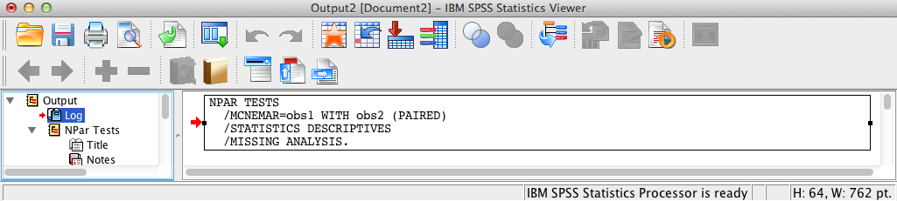
SPSS Output
The contents of the SPSS Log is the first output entry. The Log reflects the syntax used by SPSS to generate the Npar Tests output.

Slide 9
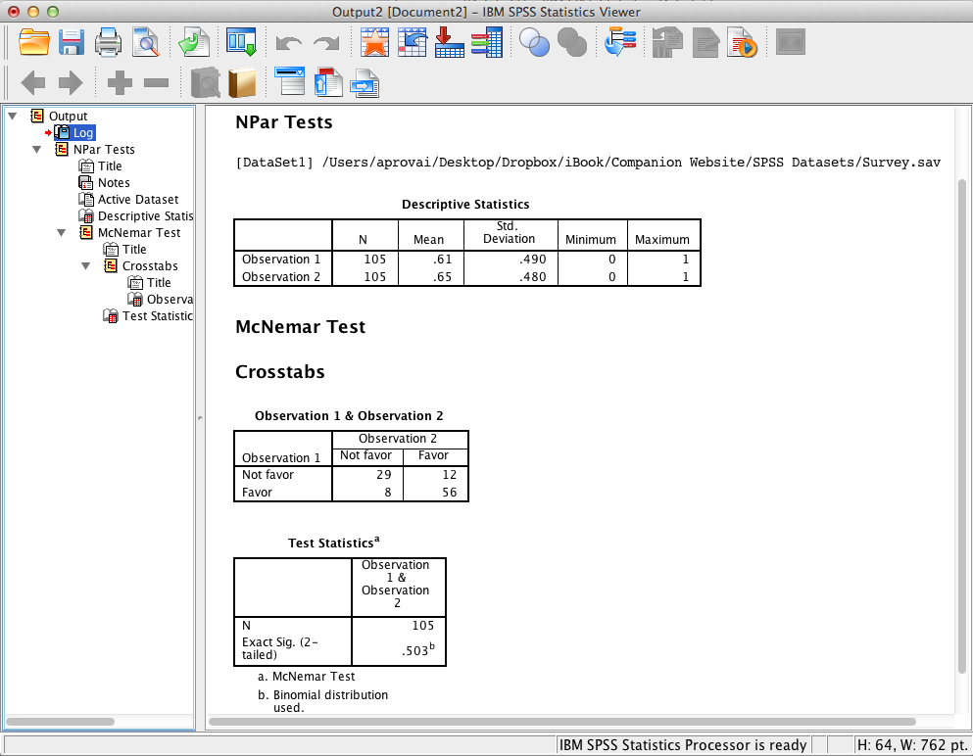
SPSS Output
SPSS output includes descriptive statistics and a 2 x 2 crosstabulation (i.e., contingency table) showing frequency counts for each cell. SPSS output also displays test statistics that show an insignificant relationship, p = .50, between Observation 1 and Observation 2 since the exact significance level >= .05 (the assumed à priori significance level).

Slide 10
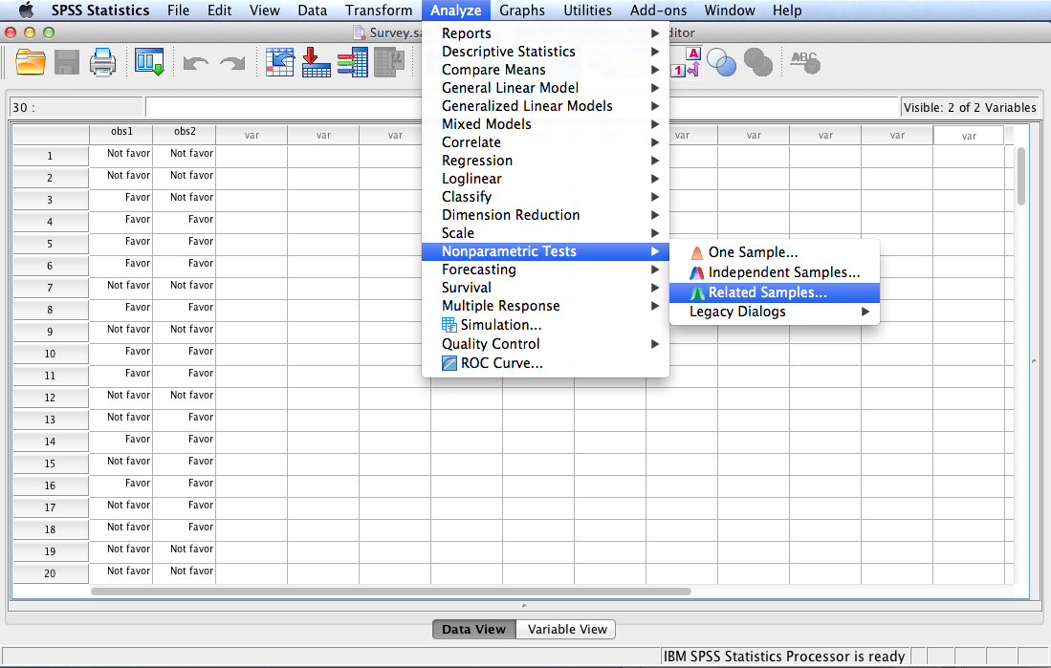
One can run the McNemar test using the Related Samples option under the Nonparametric Tests menu.

Slide 11
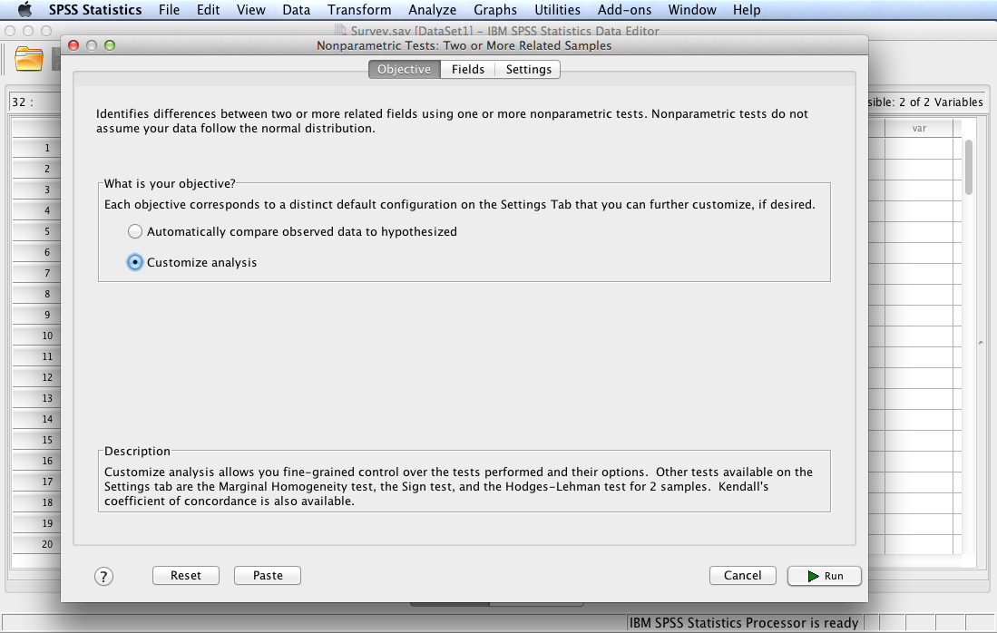
Check Customize analysis and then click the Fields tab

Slide 12
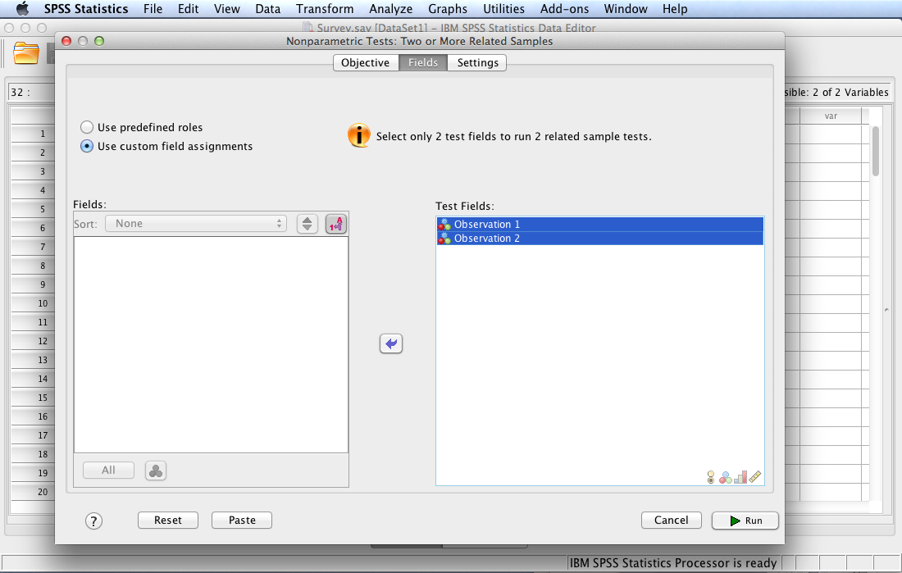
Move Observation 1 and Observation 2 to the Test Fields: box. Click the Settings tab.

Slide 13
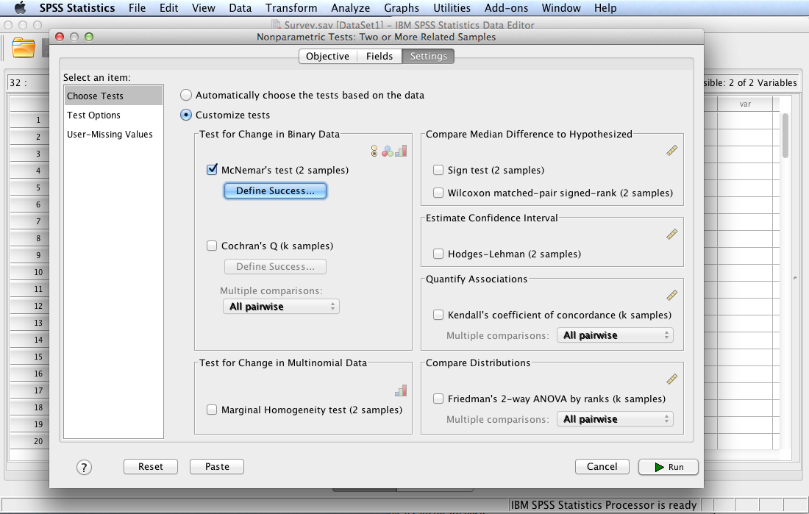
Check Customize tests and McNemar’s test (2 samples). Click Run.

Slide 14
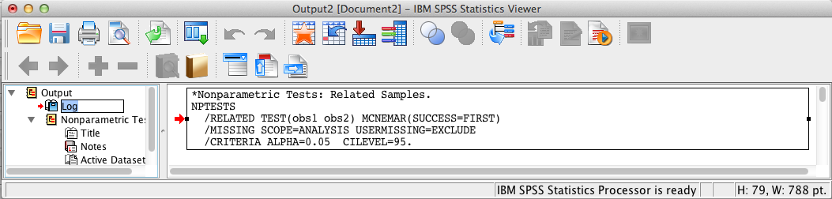
SPSS Output
The contents of the SPSS Log is the first output entry. The Log reflects the syntax used by SPSS to generate the Nonparametric Tests output.

Slide 15
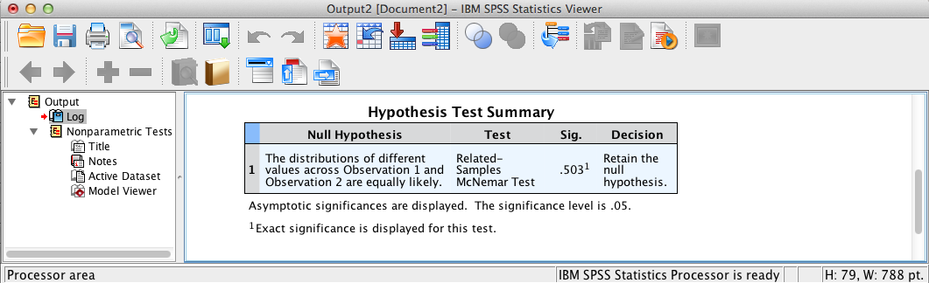
SPSS Output
The above output provides McNemar test summary statistics. Double-click the table in the SPSS output window to display the Model Viewer.

Slide 16
SPSS Output
The above output provides McNemar test summary statistics. Double-click the table in the SPSS output window to display the Model Viewer.

Slide 17
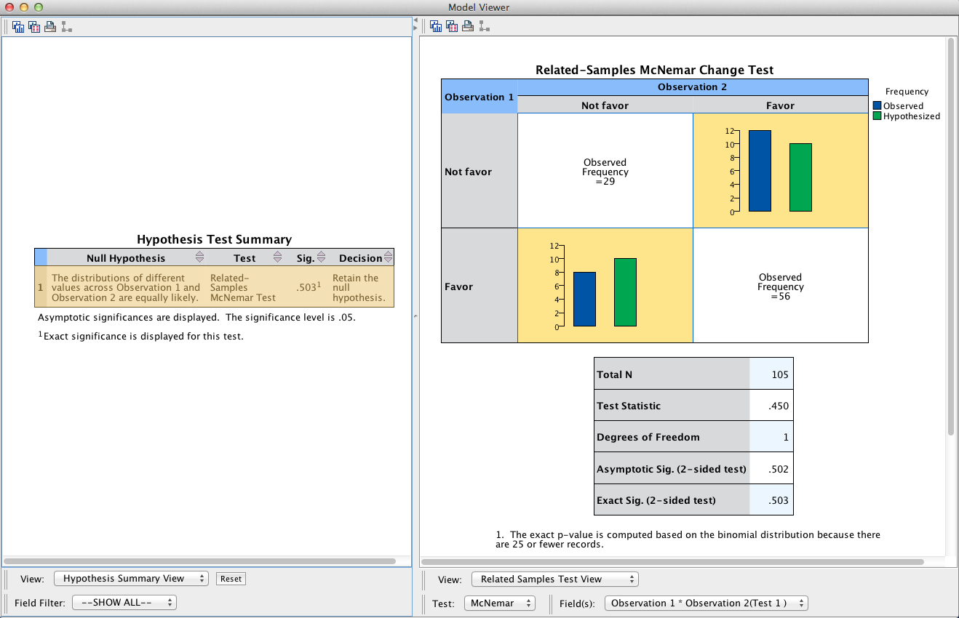
SPSS Output
Select Categorical Field View in the View: pop-up menu to display a bar chart.

Slide 18
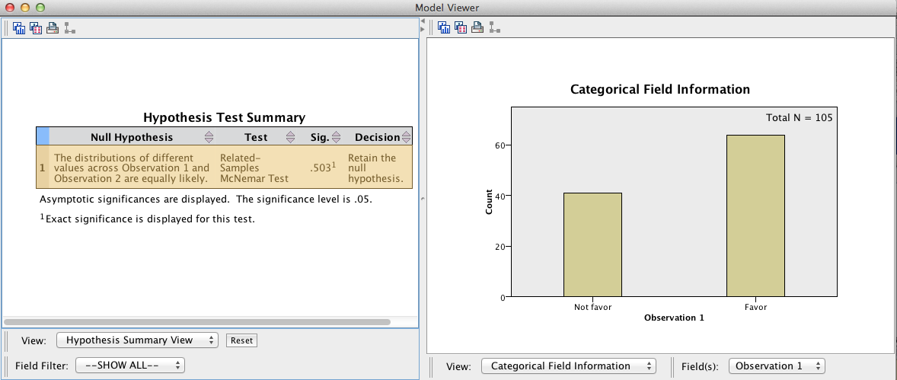
SPSS Output
Displayed in the Model Viewer is a bar chart for Observation 1. To display a bar chart for Observation 2, select Observation 2 in the Fields: pop-up menu.

Slide 19
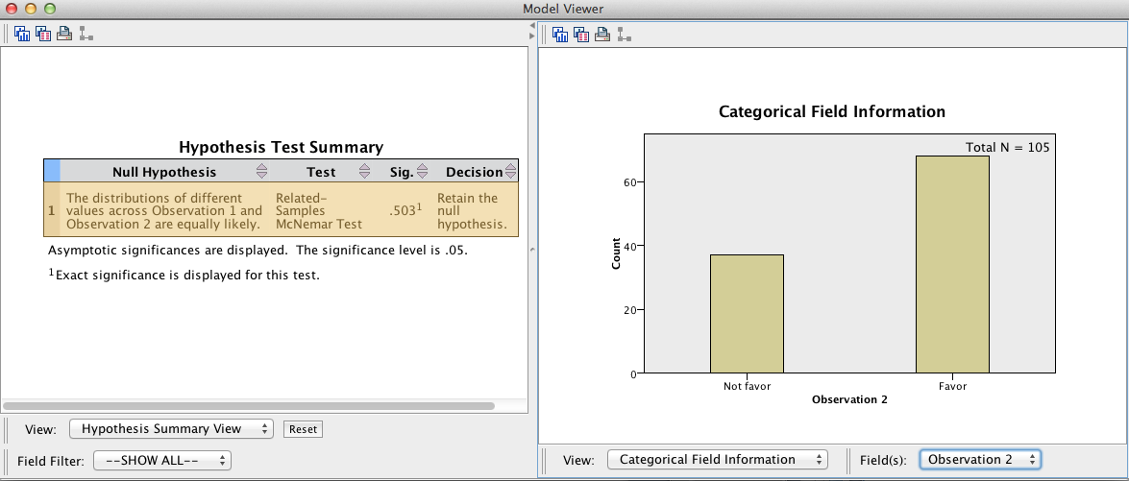
SPSS Output
The bar chart for Observation 2 is displayed.

Slide 20
McNemar Test Results Summary
H₀: There is no change in student favorability toward longer summer residencies between observation 1 and observation 2. The McNemar test is not significant, p = .50. Consequently there is insufficient evidence to reject the null hypothesis of no difference in preference.
Note: for a significant test one should also report effect size using the phi coefficient or odds ratio.

Slide 21
End of Presentation

